Slide 1
CSE 2004 – DBMS
Project Title –
E-COMMERCE MANAGEMENT
REVIEW 1
TEAM MEMBERS- REG NO. NAMES
20BAI1011 RISHITA GANGULY
20BAI1033 SHRUTI TALUKDER
20BAI1093 ANUSHA
20BPS1144 ARYAN ARORA

Slide 2
ABSTRACT
Electronic commerce is a process of doing business through computer networks. A person sitting on his chair in front of the computer can access all the facilities of the Internet to buy or sell the products.
Working of E-COMMERCE
The consumer moves through the internet to the merchant's web site. From there, he decides that he wants to purchase something, so he is moved to the online transaction server, where all of the information he gives is encrypted. Once he has placed his order, the information moves through a private gateway to a Processing Network, where the issuing and acquiring banks complete or deny the transaction. This generally takes place in no more than 5-7seconds. There are many different payment systems available to accommodate the varied processing needs of merchants, from those who have a few orders a day to those who process thousands of transactions daily. With the addition of Secure Layer Technology,E-C0mmerce is also a very safe way to complete transactions.
Purpose behind the project
In this modern era of online shopping no seller wants to be left behind, moreover due to its simplicity the shift from offline selling model to an online selling model is witnessing a rampant growth.
Therefore, as an engineer our job is to ease the path of this transition for the seller. Amongst many things that an online site requires the most important is a database system. Hence in this project we are planning to design a database where small clothing sellers can sell their product online…

Slide 3

Login page page (sample):

Slide 4
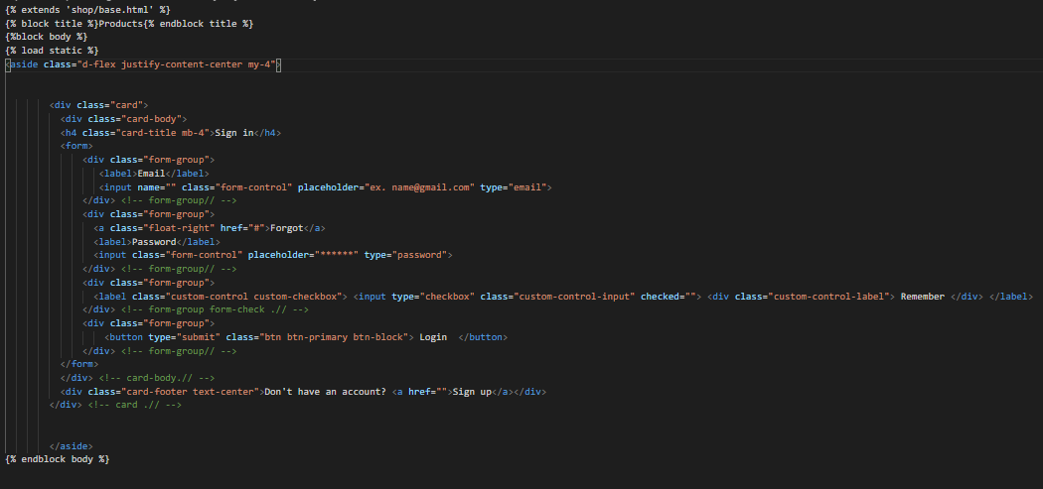
Login page code:

Slide 5

Navigation bar

Slide 6
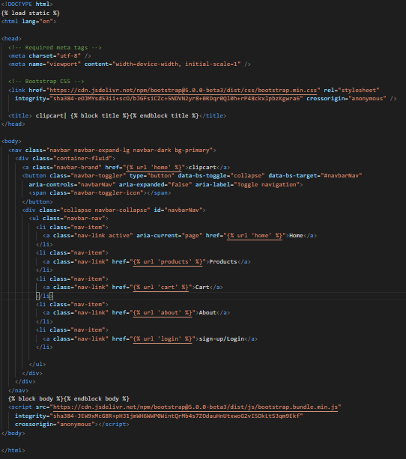
Navigation bar code:

Slide 7
Sqllite queries to create tables:
BEGIN;
--
-- Create model cart
--
CREATE TABLE "shop_cart" ("Cart_id" integer NOT NULL PRIMARY KEY AUTOINCREMENT);
--
-- Create model customer
--
CREATE TABLE "shop_customer" ("customer_id" varchar(10) NOT NULL PRIMARY KEY, "c_pass" varchar(10) NOT NULL, "address" varchar(20) NOT NULL, "pincode" integer NOT NULL, "phone_number" integer NOT NULL, "cart_id_id" integer NOT NULL REFERENCES "shop_cart" ("Cart_id") DEFERRABLE INITIALLY DEFERRED);
--
-- Create model products
--
CREATE TABLE "shop_products" ("product_id" integer NOT NULL PRIMARY KEY AUTOINCREMENT, "product_title" varchar(50) NOT NULL, "date" date NOT NULL, "product_price" integer NOT NULL, "product_size" varchar(2) NOT NULL, "quantity" integer NOT NULL, "seller_id" varchar(10) NOT NULL, "image" varchar(100) NOT NULL);

Slide 8
-- Create model seller​
--​
CREATE TABLE "shop_seller" ("seller_id" varchar(10) NOT NULL PRIMARY KEY, "s_pass" varchar(10) NOT NULL, "name" varchar(20) NOT NULL, "address" varchar(10) NOT NULL);​
--​
-- Create model seller_phone_number​
--​
CREATE TABLE "shop_seller_phone_number" ("id" integer NOT NULL PRIMARY KEY AUTOINCREMENT, "phone_num" integer NOT NULL, "seller_id_id" varchar(10) NOT NULL REFERENCES "shop_seller" ("seller_id") DEFERRABLE INITIALLY DEFERRED);​
--​
-- Create model payment​
--​
CREATE TABLE "shop_payment" ("payment_id" varchar(10) NOT NULL PRIMARY KEY, "payment_date" date NOT NULL, "payment_type" varchar(10) NOT NULL, "cart_id_id" integer NOT NULL REFERENCES "shop_cart" ("Cart_id") DEFERRABLE INITIALLY DEFERRED, "customer_id_id" varchar(10) NOT NULL REFERENCES "shop_customer" ("customer_id") DEFERRABLE INITIALLY DEFERRED);​
--​
-- Create model cart_items​
--​
CREATE TABLE "shop_cart_items" ("id" integer NOT NULL PRIMARY KEY AUTOINCREMENT, "qty" integer NOT NULL, "date_added" date NOT NULL, "cart_id_id" integer NOT NULL REFERENCES "shop_cart" ("Cart_id") DEFERRABLE INITIALLY DEFERRED, "product_id_id" integer NOT NULL REFERENCES "shop_products" ("product_id") DEFERRABLE INITIALLY DEFERRED);​

Slide 9
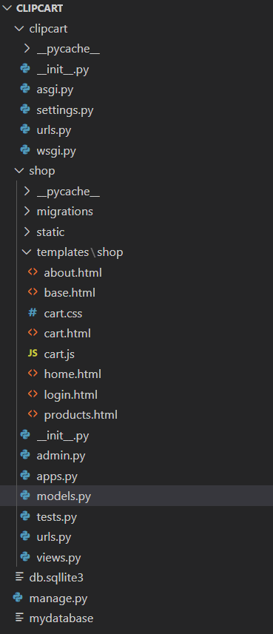
Basic structure of site:

Slide 10
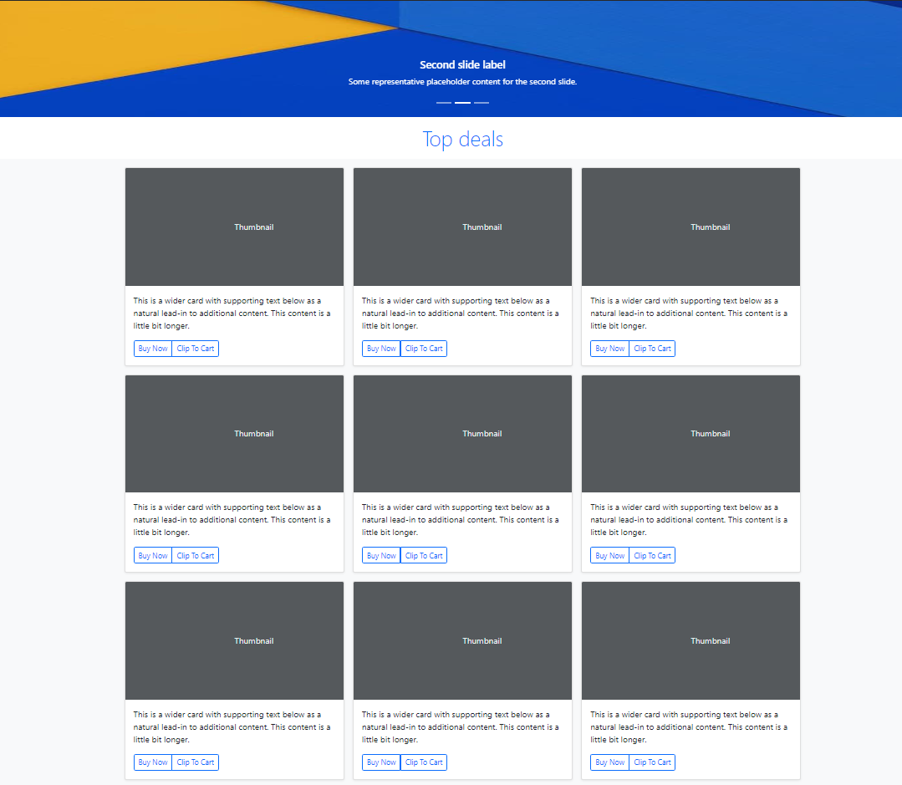
home page sample:

Slide 11
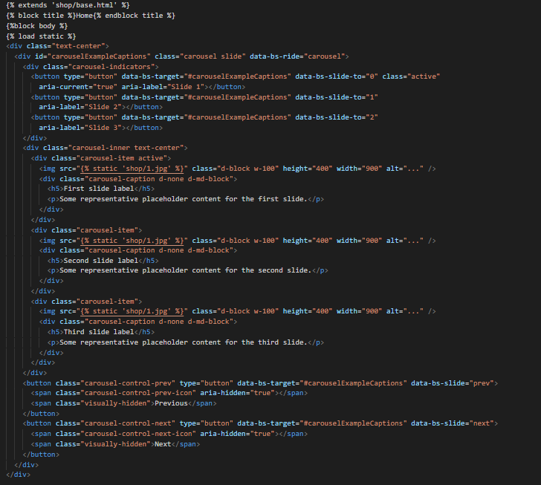
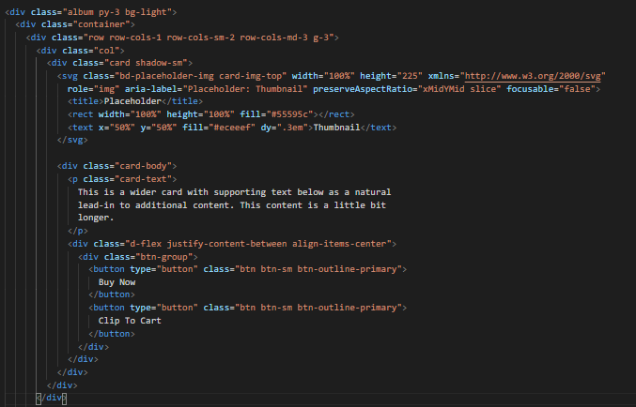
Code for carousel:
Code for card:

Slide 12
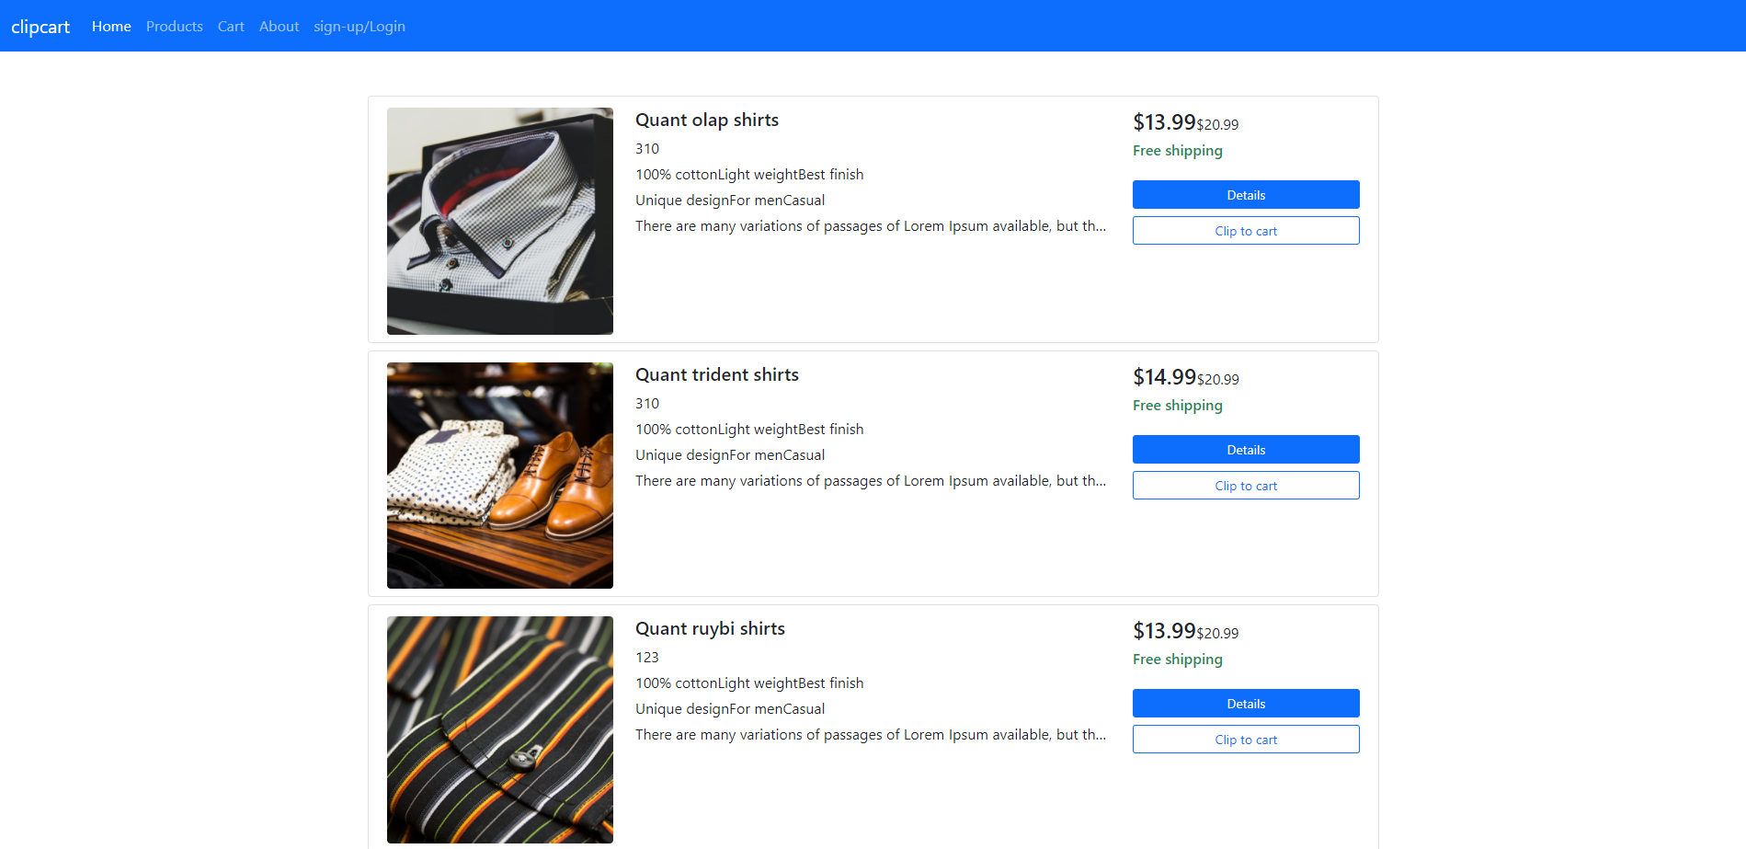
Products page (sample):

Slide 13
Products page code(sample):

